Slide 1
Java IOs
RES, Lecture 1
Olivier Liechti

Slide 2
Agenda
Week 1
Universal API
Sources, Sinks and Streams
Performance and Buffering
Week 2
The Decorator Pattern and The Mighty Filter Classes
Binary vs. Character-Oriented IOs
Shit Happens... Dealing with IO Exceptions

Slide 3
Survey
“Pas sûr de dormir pendant ce semestre”
- anonymous student
“Au vue de mes dernières réponses je souhaiterai pouvoir y répondre "Oui je maitrise" à la fin”
- anonymous student
“apprendre des trucs cools”
- anonymous student

Slide 4
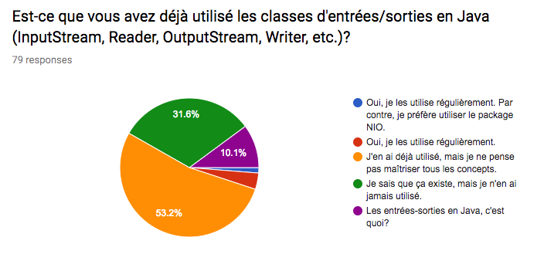
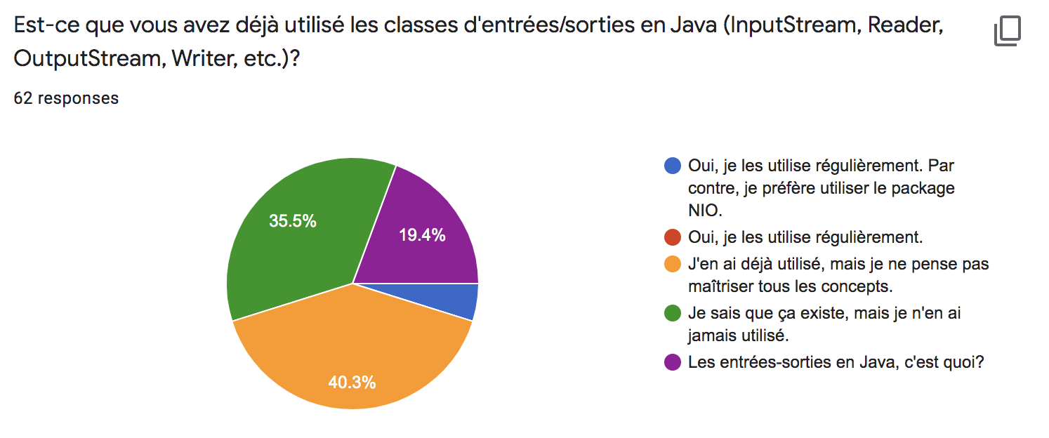
2019

Slide 5
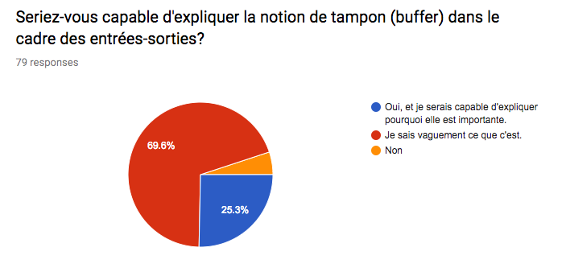
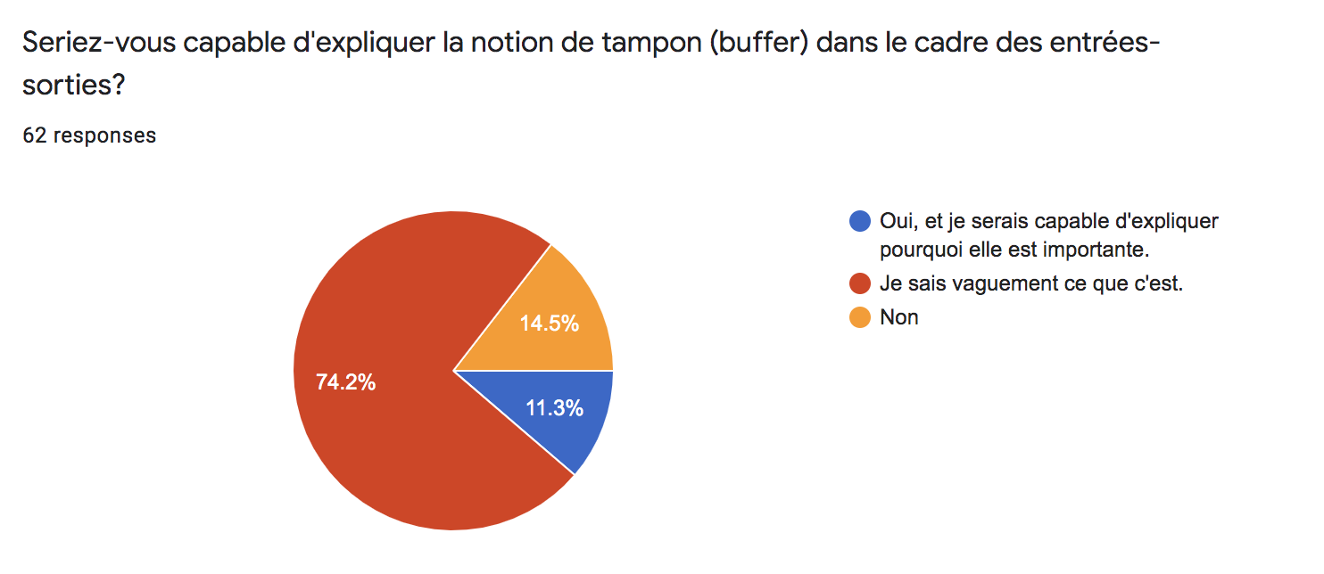
2019

Slide 6
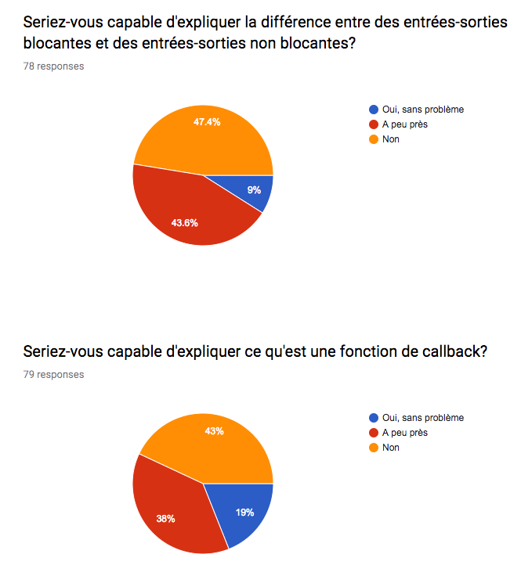
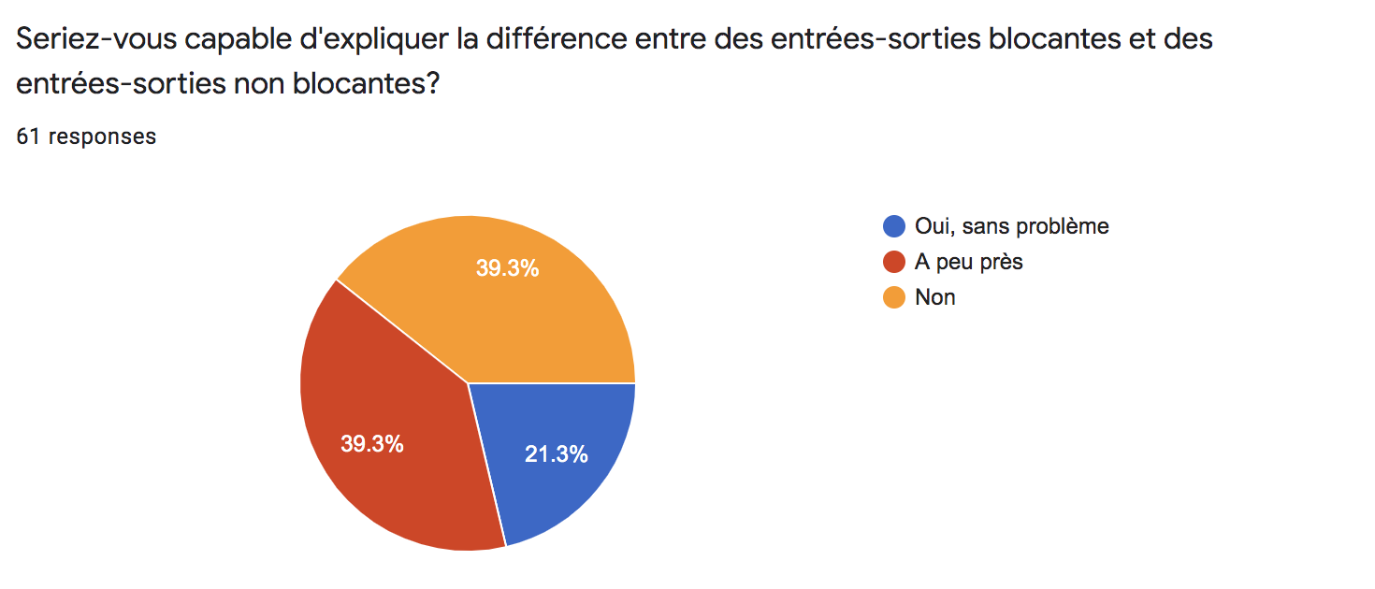
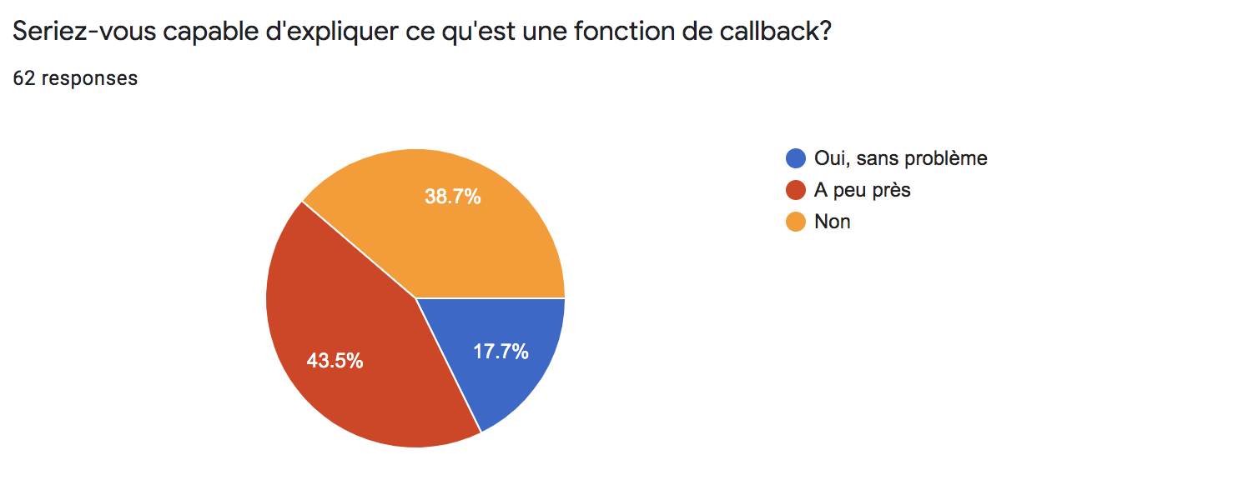
2019

Slide 7
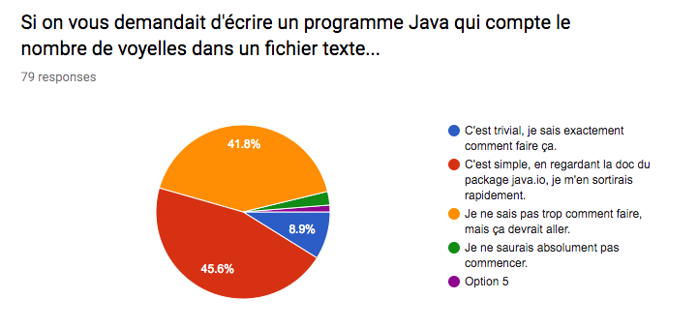
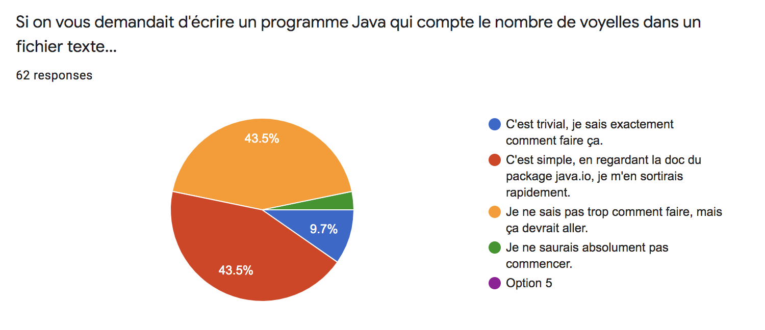
2019

Slide 8
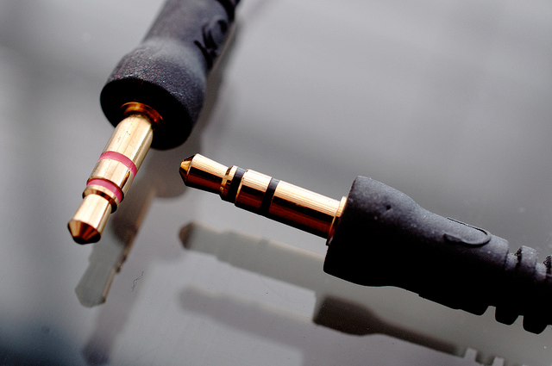
Universal API

Slide 9




What do we mean by IO?
Your Application
read
write

Slide 10
A Universal API
At the end of the day, whether you are "talking" to a file, to a network endpoint or to a process does not matter.
You are always doing the same thing: reading and/or writing bytes or characters.
The Java IO API is the toolbox that you need for that purpose.

Slide 11
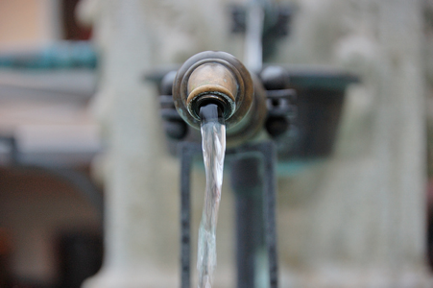
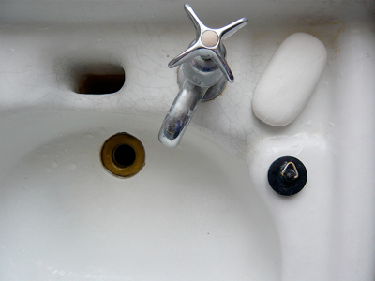
Sources, Sinks & Streams

Slide 12
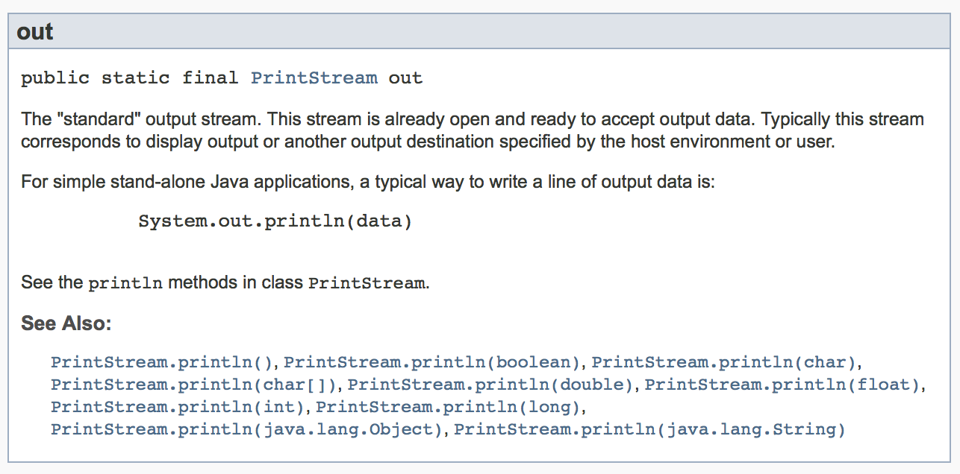
System.out.println(“I like IO”);

Slide 13
Streams
When we talk about “input/output”, or IOs, we think about producing and consuming streams of data.
There are different sources that contain or produce data.
There are also different destinations that receive or consume data.
Think about files, network endpoints, memory, processes, etc.
Your program can read data from a stream. Your program can write data to a stream.
data
source
read
your program
write
data
destination

Slide 14
What can you do with IO streams?
Read data from a file. Think about a program that reads an XML/JSON configuration file at start-up. Think about your favorite text editor.
Write data to a file. Think about a java compiler that produces .class files.
Receive data over the network. Think about a web server receiving requests from clients.
Send data over the network. Think about the same server sending responses to the clients.
Exchange data with other programs (processes) running on the same machine.
Etc.
In the end, it’s always the same thing... it’s about reading and writing data!
If it’s the same thing, then we want to have a single API for dealing with all sorts of IOs!

Slide 15
Classes in the java.io package (1)
InputStream
OutputStream
FileInputStream
FileOutputStream
ByteArrayInputStream
ByteArrayOutputStream
PipedInputStream
PipedOutputStream
FilterInputStream
FilterOutputStream
BufferedInputStream
BufferedOutputStream

Slide 16
Classes in the java.io package (2)
Reader
Writer
PrintWriter
FileReader
FileWriter
CharArrayReader
CharArrayWriter
StringReader
StringWriter
FilterReader
FilterWriter
BufferedReader
BufferedWriter

Slide 17
Bytes vs. Characters
10001011
00011010
11110101
10101010
There are different types of data sources. Some sources produce binary data. Other sources produce textual data.
It’s always a series of 0’s and 1’s. The real question is : “how do you interpret these bits”?
When you deal with textual data, the interpretation is not always the same. It depends on the “character encoding system”?
When you deal with IOs, you have to use different classes for processing binary, respectively textual data. Otherwise, you will corrupt data!
decoding
decoding
élève
?l?ve
For binary data, use inputStreams and outputStreams.
For text data, use readers and writers.

Slide 18
Reading Bytes, One at The Time
int b = fis.read();
while ( b != -1 ) {
// b has an int value between -1 and 255
// -1 indicates that we are at the end of the stream
// b can be casted to a byte, remember that in Java,
// bytes are signed and have values in the range [-128..127].
b = fis.read();
}
This is a blocking call
Or if you absolutely want to save 1 line...
int b;
while ( (b = fis.read()) != -1 ) {
}

Slide 19
Reading Bytes, in Blocks
final int BUFFERSIZE = 255;
byte[] buffer = new byte[BUFFERSIZE];
int numberOfNewBytes = fis.read(buffer);
// we know that numberOfNewBytes bytes have been read
// we know that these bytes are available in the buffer
// WARNING: there might be left-over junk after these bytes!
while ( numberOfNewBytes != -1 ) {
// do something with the bytes in buffer[0..numberOfNewBytes-1]
// ignore what is left in buffer[numberOfNewBytes.. BUFFERSIZE]
// read the next chunk of bytes
numberOfNewBytes = fis.read(buffer);
}

Slide 20
Writing Bytes
Write 1 byte
OutputStream os = ...;
int b;
// The byte to be written is the eight low-order b.
// The 24 high-order bits of b are ignored. So, b can have an
// int value in the range [0..255]
os.write(b);
This is a blocking call
Write a block of bytes
OutputStream os = ...;
byte[] data = new byte[BLOCK_SIZE];
data[3] = 22; data[4] = 5; data[5] = 9; data[6] = 7;
// data[0..2] contains junk, data[7..BLOCK_SIZE-1] too
int offset = 3; // because we have started to fill at slot 3
int length = 4; // because we have filled 4 slots
os.write(data, offset, length);

Slide 21
Design Your Code to Be Universal
/**
* This interface will work only for data sources on the file
* system. In the method implementation, I would need to create
* a FileInputStream from f and read bytes from it.
*/
public interface IPoorlyDesignedService {
public void readAndProcessBinaryDataFromFile(File f);
}
data source
vs
/**
* This interface is much better. The client using the service
* has a bit more responsibility (and work). It is up to the
* client to select a data source (which can still be a file,
* but can be something else). The method implementation
* will ignore where it is reading bytes from. Nice for reuse,
* nice for testing.
*/
public interface INicelyDesignedService {
public void readAndProcessBinaryData(InputStream is);
}
stream

Slide 22
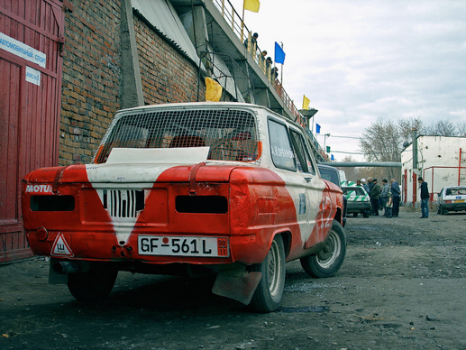
Performance and Buffering

Slide 23
Buffered IOs
Do you know what happens when you do a
int c = read();
?

Slide 24
Buffered IOs
It’s a bit like when you are thirsty and feel like drinking something...
!

Slide 25

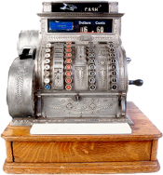
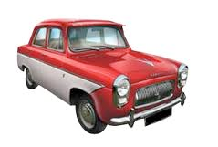

Buffered IOs
It takes you 56’ to sip a beer
20 min
5 min
10 min
20 min
1 min

Slide 26
Buffered IOs
Thirsty again...
?

Slide 27
Buffered IOs
It takes you 56’ again to sip the next beer
20 min
5 min
10 min
20 min
1 min

Slide 28
Buffered IOs
Can we do better...
?

Slide 29

Buffered IOs
It still takes you 56’ to bring back a pack of beers...
20 min
5 min
10 min
20 min
1 min

Slide 30
Buffered IOs
Thirsty again...
?

Slide 31
Buffered IOs
It now only takes 2 minutes to sip the next one!
1 min
1 min

Slide 32
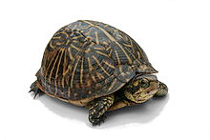

Buffered IOs
Coming back to
int c = read();
If you don’t use buffered IOs, calling read() will issue one system call to retrieve one single byte... which is not efficient.
With buffered IOs, calling read() will pre-fetch “several” bytes and store it in a temporary memory space (i.e. in a buffer). “several” defines the buffer size.
Subsequent calls to read() will be able to fetch bytes directly from the buffer, which is very fast.

Slide 33
Buffered IOs
What about
write(c);
?

Slide 34
Buffered IOs
It’s the same thing! There is on gotcha:
Sometimes, you want to immediately send the content of the buffer to the output stream.
os.flush();

Slide 35
Buffered IOs in Java
Later on, we will introduce the Decorator Design Pattern
Using buffered IOs is as simple as decorating any of your byte or character streams (don’t forget about flushing buffered output streams when required!).
InputStream slow;
BufferedInputStream fast = new BufferedInputStream(slow);
OutputStream slow;
BufferedOutputStream fast = new BufferedOutputStream(slow);
Reader slow;
BufferedReader fast = new BufferedReader(slow);
Writer slow;
BufferedWriter fast = new BufferedWriter(slow);

Slide 36

Example: 01-BufferedIOBenchmark
What is the real impact of buffered IOs on performance?

Slide 38
BufferedIOBenchmark
Step 1: code walkthrough and live demo
Step 2: how can we improve the code to be able to analyze results?

Slide 39
Code walkthrough
Write and read random data to/from disk.
4 strategies (with/without BufferedIOs, operations on byte arrays/single bytes)
byte arrays
byte-by-byte
byte arrays
byte-by-byte
write
write
read
read
Buffered
Buffered
write
read
Non
buffered
write
Non
buffered
read

Slide 40
Code walkthrough
/**
* This enum is used to describe the 4 different strategies for doing the IOs
*/
public enum IOStrategy {
ByteByByteWithoutBufferedStream,
ByteByByteWithBufferedStream,
BlockByBlockWithoutBufferedStream,
BlockByBlockWithBufferedStream
};
// we will write and read test files at this location
final static String FILENAME_PREFIX = "test-data";
// we will write and read 10 MB files
final static long NUMBER_OF_BYTES_TO_WRITE = 1024 * 1024 * 10;

Slide 41
Code walkthrough
// this takes care of opening CONCRETE output streams (connected to files)
private void produceTestData(IOStrategy ioStrategy, long numberOfBytesToWrite, int blockSize);
// this takes care of producing a random stream of bytes, based on a strategy
private void produceDataToStream(OutputStream os, IOStrategy ioStrategy, long numberOfBytesToWrite, int blockSize) throws IOException;
// this takes care of opening CONCRETE input streams
private void consumeTestData(IOStrategy ioStrategy, int blockSize);
// this takes care of consuming the stream of bytes, based on a strategy
private void consumeDataFromStream(InputStream is, IOStrategy ioStrategy, int blockSize) throws IOException

Slide 42
Timer
public class Timer {
private static long timestamp = 0;
public static void start() {
timestamp = System.currentTimeMillis();
}
public static long takeTime() {
if (timestamp == 0) {
timestamp = System.currentTimeMillis();
}
long ellapsedTime = System.currentTimeMillis() - timestamp;
timestamp = System.currentTimeMillis();
return ellapsedTime;
}
}

Slide 43
Printing the measures on the console is a first step, but...
What is we have 10, 20 strategies?
What if we have 5 parameters for each strategy?
How can we analyze the data more efficiently?
How can we archive the results?
What is we want to analyze/chart in Excel?
What would you do to improve the code?

Slide 44

Back to Lab-00...

Slide 45
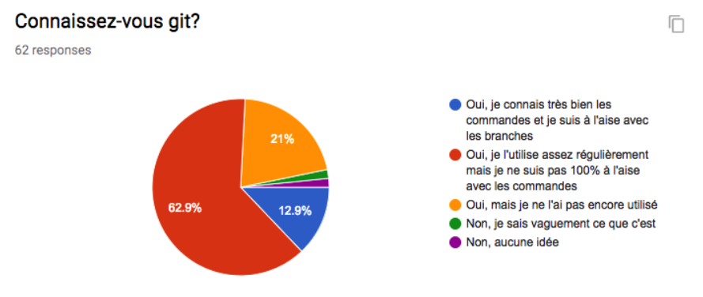
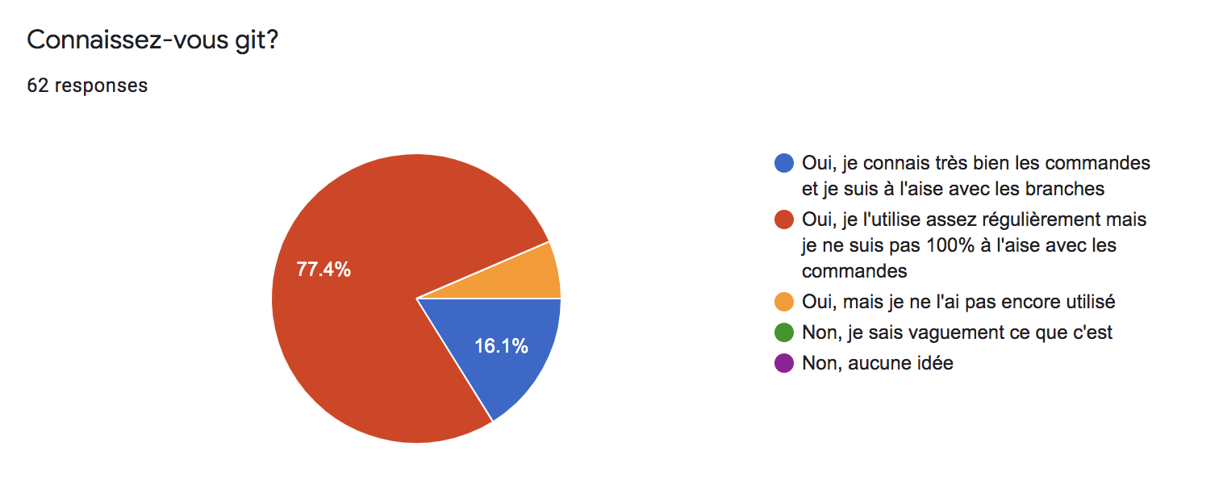

Slide 46
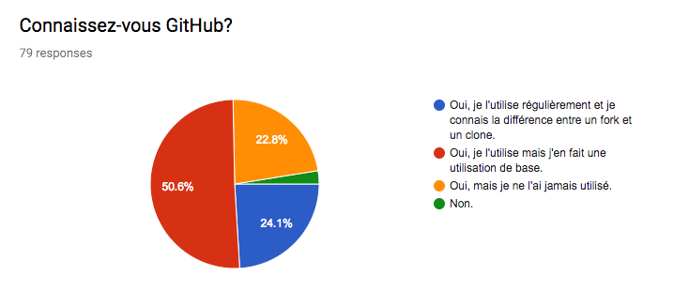
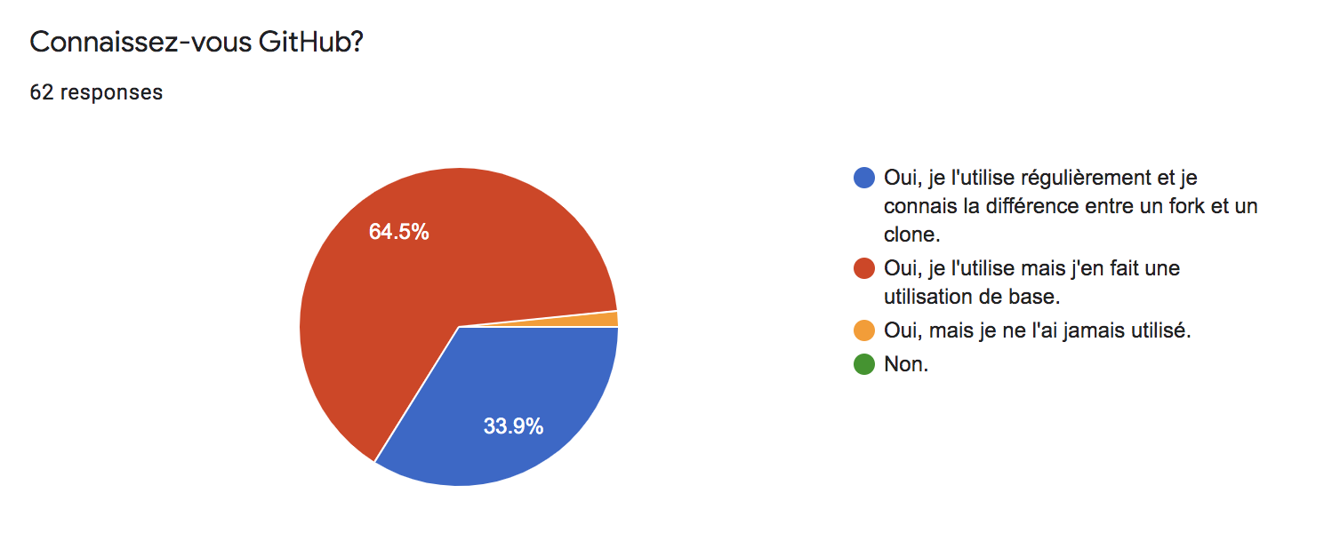

Slide 47
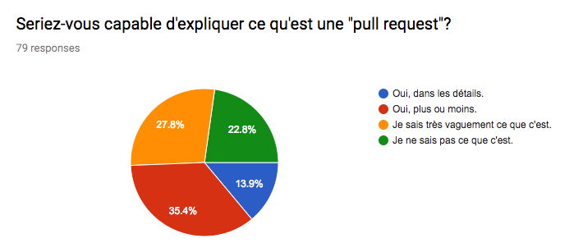
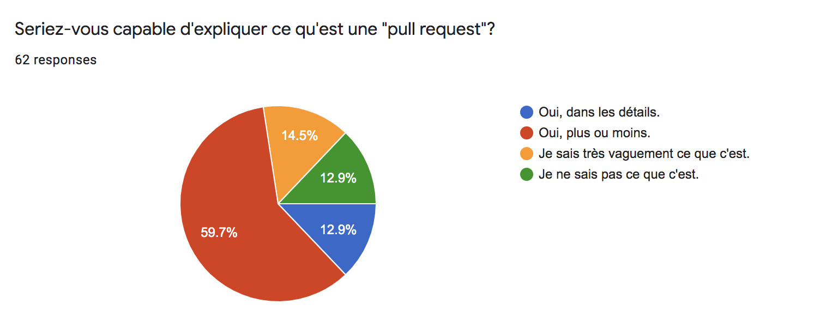

Slide 48
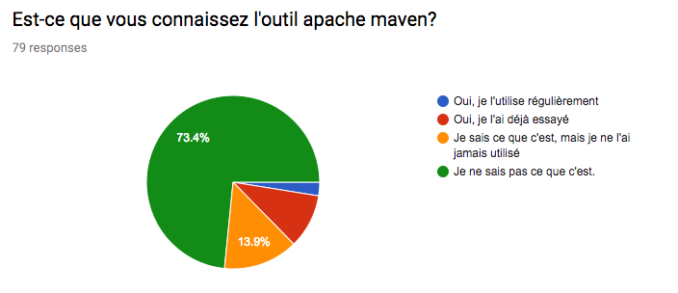
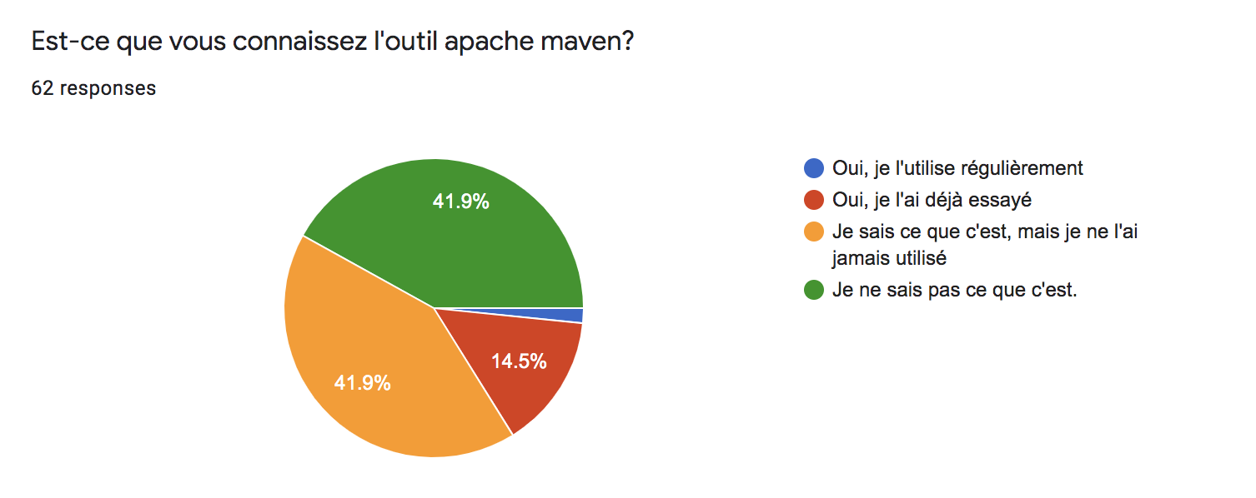

Slide 49
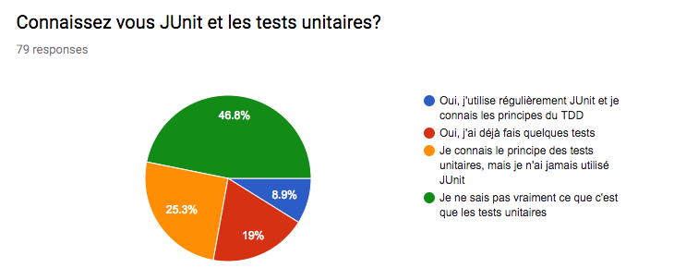
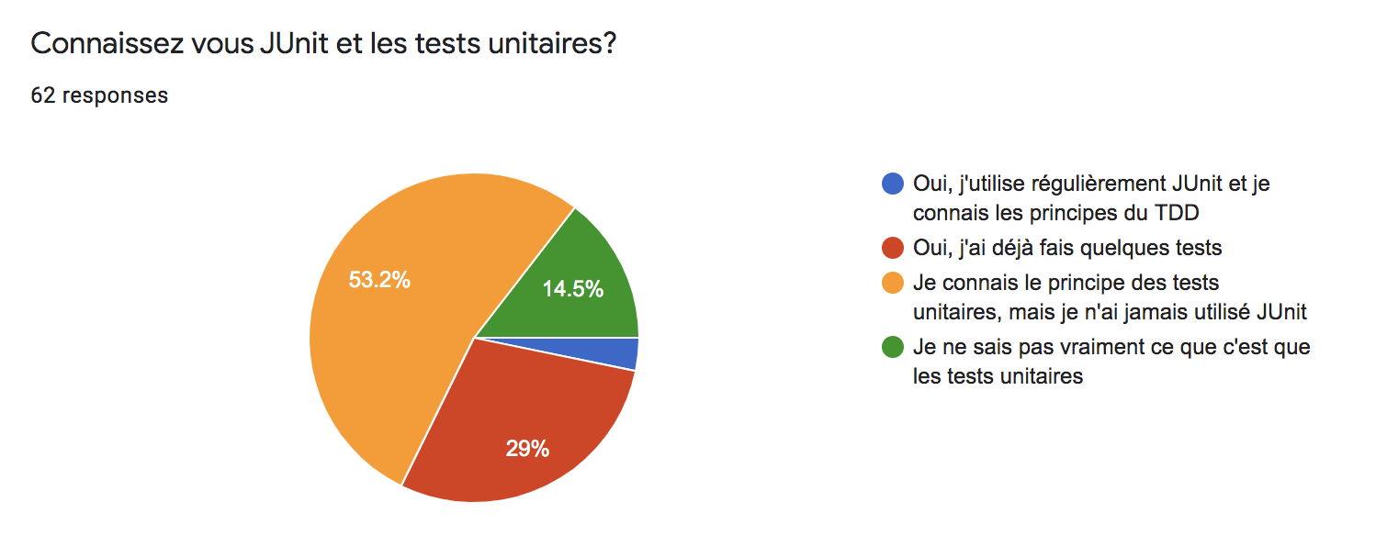

Slide 50

The Mighty Filter Classes

Slide 51
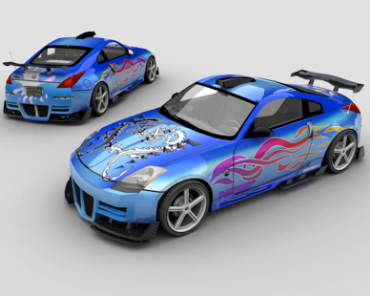

The Decorator Design Pattern
The decorator design pattern is a solution that is often used when creating object-oriented models.
It makes it possible to add behavior to an existing class, without modifying the code of this class. In other words, it makes it possible to decorate an existing class with additional behaviors.
The design pattern also makes it possible to define a collection of decorators, and to combine them in arbitrary ways at runtime. In other words, it is possible to decorate a class with several behaviors.

Slide 52
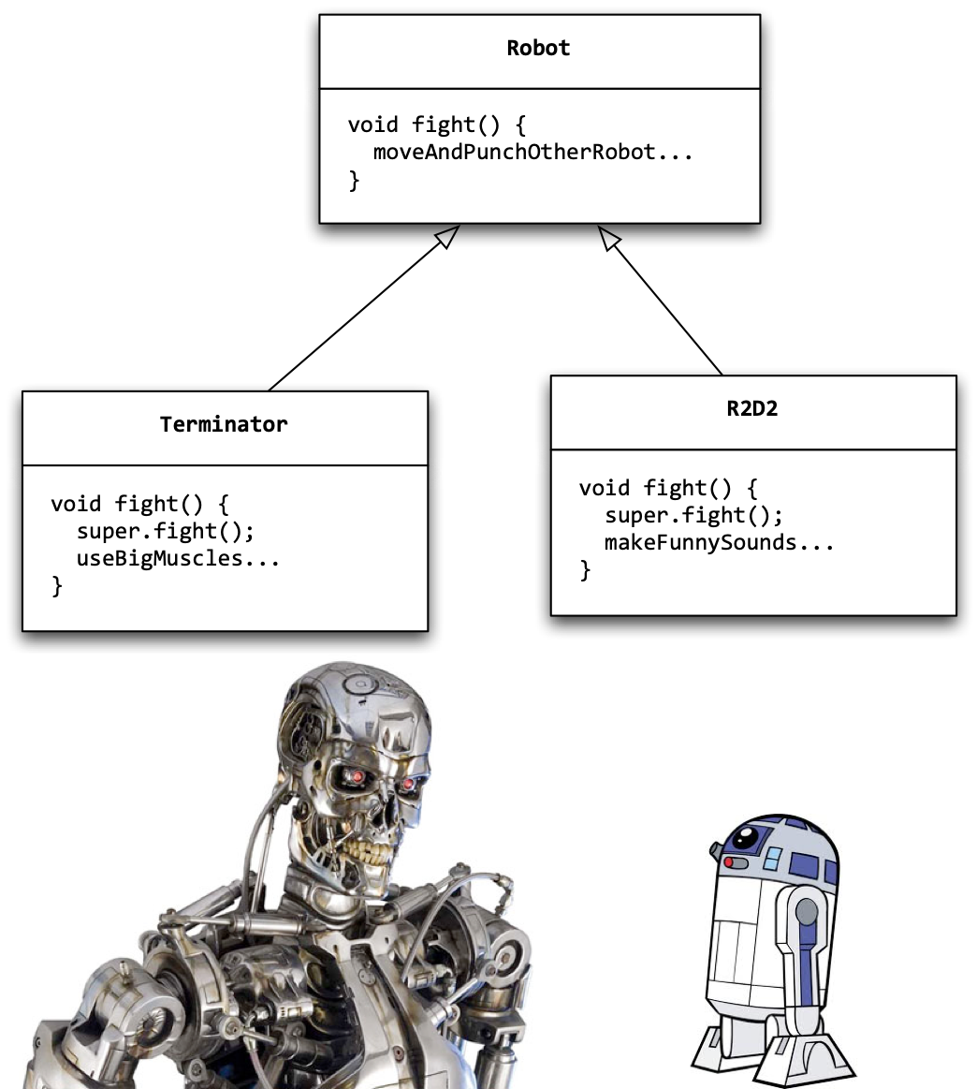
Example : Fighting Robots
Robot bigOne = new Terminator();
Robot smallOne = new R2D2();
bigOne.fight();
smallOne.fight();
--
bigOne > useBigMuscles
smallOne > makeFunnySounds
bigOne wins.

Slide 53
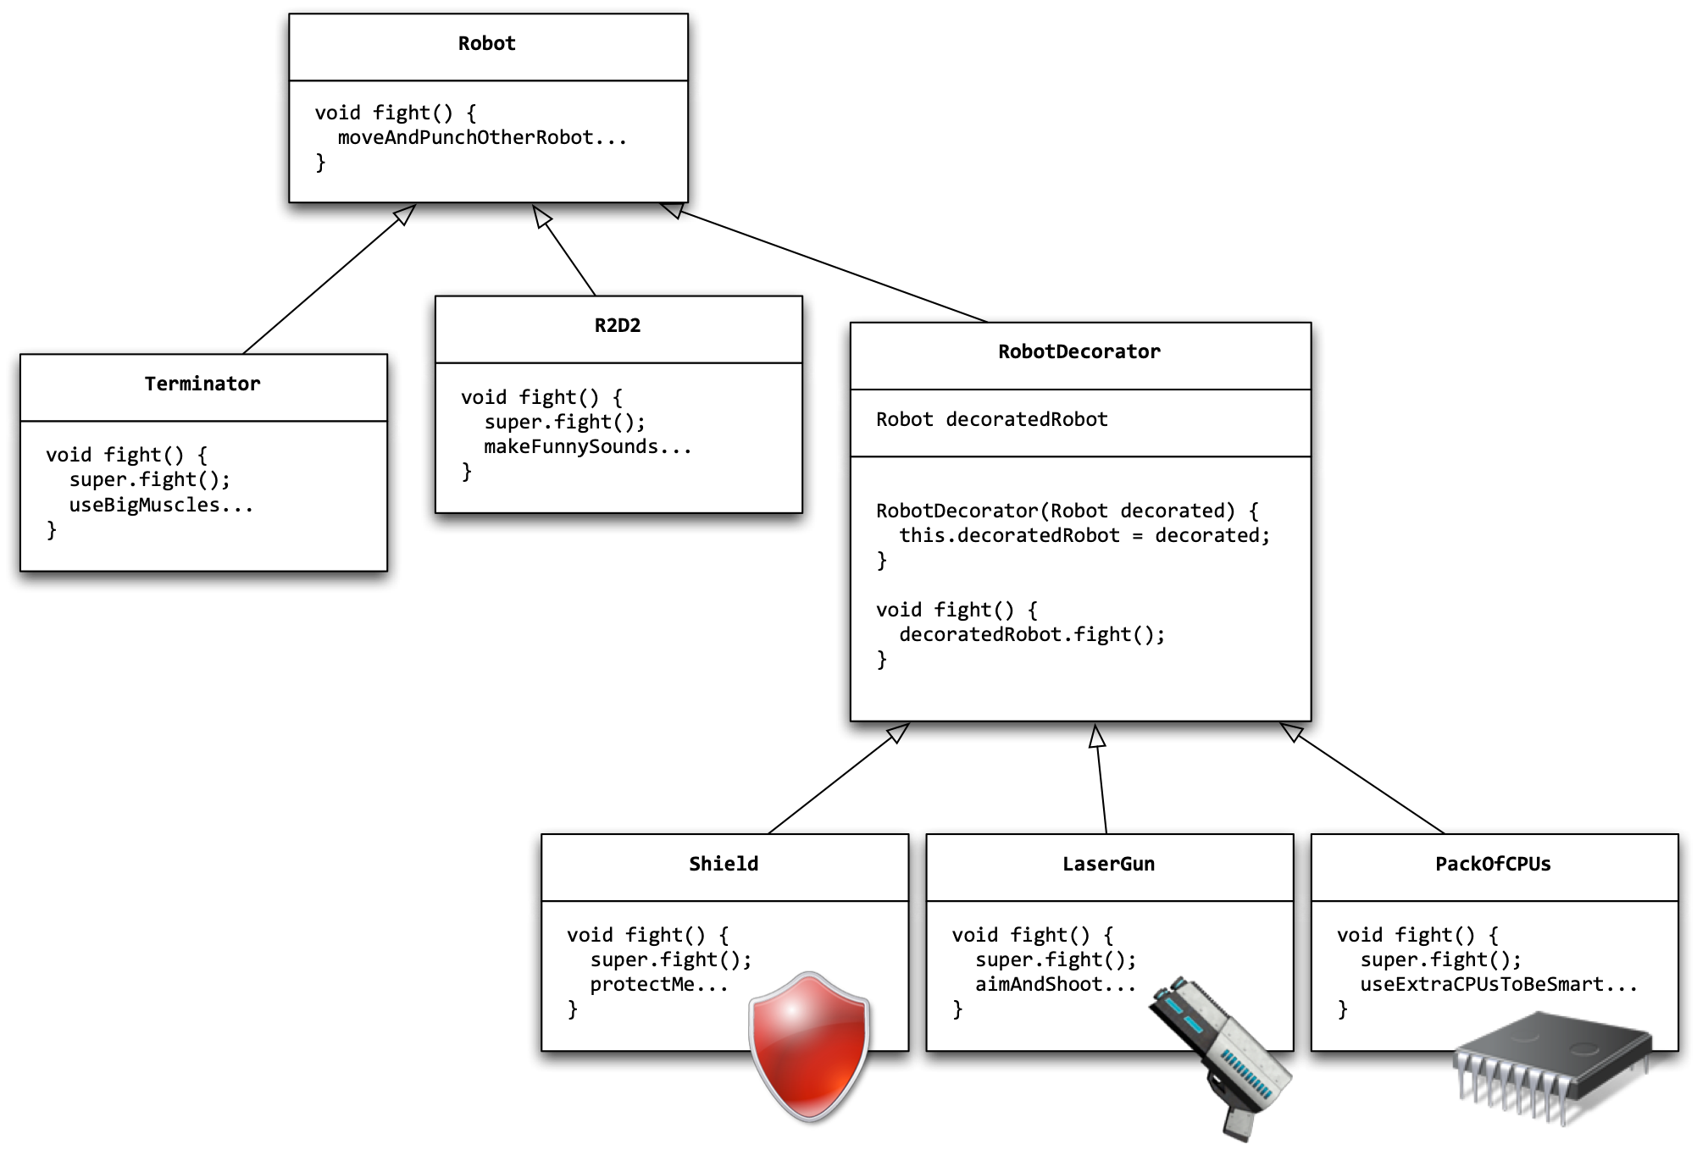
Example : Decorators for Robots

Slide 54


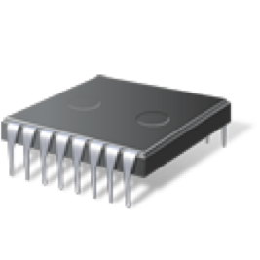
Example : Decorated Robots
Robot bigOne = new Terminator();
Robot decoratedSmallOne =
new Shield(
new LaserGun(
new PackOfCPU(
new R2D2()
)
)
);
bigOne.fight();
decoratedSmallOne.fight();
--
bigOne > useBigMuscles
smallOne > makeFunnySounds, useExtraCPUsToBeSmart, aimAndShoot, protectMe
decoratedSmallOne wins.

Slide 55
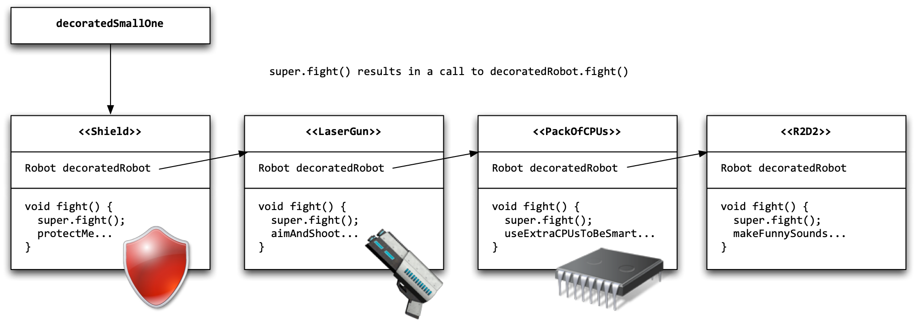
Invocation Chain
decoratedSmallOne.fight()
-> shield.fight();
-> laserGun.fight() + protectMe;
-> packOfCPUs.fight() + aimAndShoot + protectMe
-> R2D2.fight() + useExtraCPUsToBeSmart + aimAndShoot + protectMe
-> makeFunnySounds + useExtraCPUsToBeSmart + aimAndShoot + protectMe.

Slide 56
Example: 02-FileIOExample (2)

Slide 57
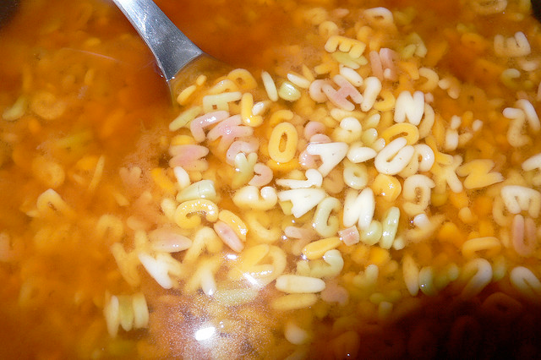
Binary vs Character-Oriented IOs

Slide 58
Classes in the java.io package (1)
InputStream
OutputStream
FileInputStream
FileOutputStream
ByteArrayInputStream
ByteArrayOutputStream
PipedInputStream
PipedOutputStream
FilterInputStream
FilterOutputStream
BufferedInputStream
BufferedOutputStream

Slide 59
Classes in the java.io package (2)
Reader
Writer
PrintWriter
FileReader
FileWriter
CharArrayReader
CharArrayWriter
StringReader
StringWriter
FilterReader
FilterWriter
BufferedReader
BufferedWriter

Slide 60
Bytes vs. Characters
10001011
00011010
11110101
10101010
There are different types of data sources. Some sources produce binary data. Other sources produce textual data.
It’s always a series of 0’s and 1’s. The real question is : “how do you interpret these bits”?
When you deal with textual data, the interpretation is not always the same. It depends on the “character encoding system”?
When you deal with IOs, you have to use different classes for processing binary, respectively textual data. Otherwise, you will corrupt data!
decoding
decoding
élève
?l?ve
For binary data, use inputStreams and outputStreams.
For text data, use readers and writers.

Slide 61
Bytes vs. Characters
“A byte is a sequence of 8 bits. Period.”
“A character is the interpretation of a sequence of n bits. Producer and consumer need to agree on how to do this interpretation.”
1000001 → 1000001 → 1000001
✓ ‘A’ ⇝ 1000001 ⇝ ‘A’
✗ ‘A’ ⇝ 1000001 ⤳ ‘⧇’

Slide 62
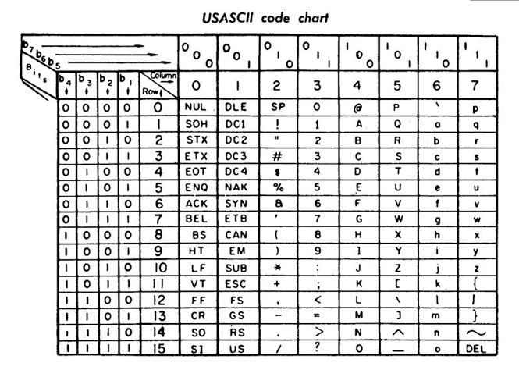
Example : the ASCII encoding
‘A’
1000001
65
64-32-16-08-04-02-01

Slide 63
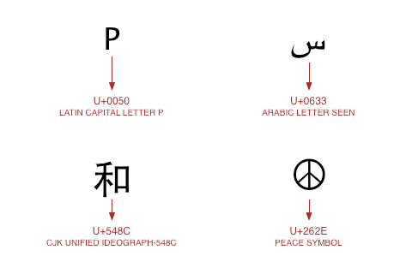
Example : Unicode & UTF-8 encoding
Unicode is an industry standard for representing text in almost all world languages (e.g. japanese, hebrew, arabic, etc.).
With Unicode, every character is associated with a “code point”, which is nothing else than a number. It is expressed as ‘U+’ followed by an hexadecimal value.
For instance, ‘A’ has the code point U+41 (41 is 65 in hexadecimal).
The code points for latin characters have the same value as in the ASCII encoding.
UTF-8 is one of the encoding systems used to represent characters of the Unicode character set.
UTF-8 is a variable-length encoding system. Some characters are encoded with 1 byte, others with 2 bytes, etc.
http://wiki.secondlife.com/wiki/Unicode_In_5_Minutes

Slide 64
Java & Unicode
Java uses the unicode character encoding system. This means that your program can manipulate characters in different languages and alphabets.
Every char variable is defined by 2 bytes, i.e. 16 bits.
Think about what happens when you read data from a source. You will see a series of 1’s and 0’s. You know that these bits represent characters, but how do you know how to interpret them? The answer will depend on the source! Or more precisely, it will depend on the encoding system used by the source.
Same problem when you produce data. You have text data in memory (char and String variables). You want to understand and control how this data is transformed in a series of bits. This is important if you want that other parties are able to read what you have produced!

Slide 65
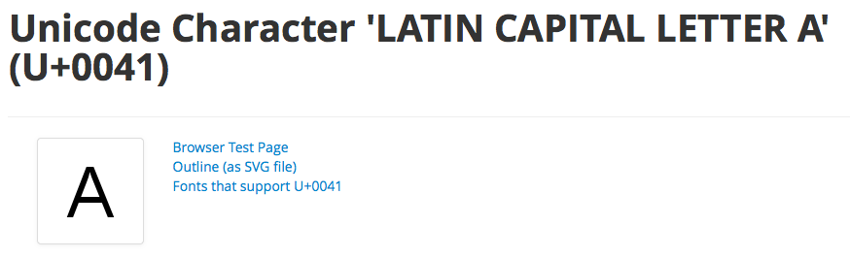
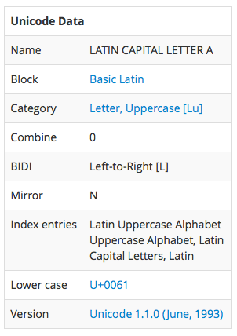
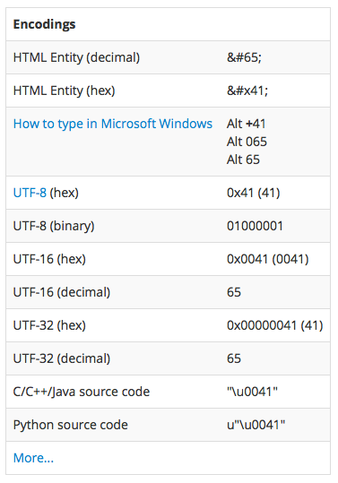
Exploring the Unicode Charset
http://www.fileformat.info/info/unicode/char/41/index.htm

Slide 66
Example: 03-CharacterIODemo
How do I avoid these damn ?l?ves when I want to see élèves?

Slide 67
CharacterIODemo
Step 1: code walkthrough and live demo (10’)
Step 2: self-study of the code and individual experiments

Slide 68
Demo
When I encode 'ABC élève 広島' (12 chars) with encoding US-ASCII, I generate 12 bytes.
01000001 65
01000010 66
01000011 67
00100000 32
00111111 63
01101100 108
00111111 63
01110110 118
01100101 101
00111111 63
00111111 63
00111111 63
If I decode the result with the default encoding for this JVM (UTF-8), I get: ABC ?l?ve???
If I decode the result with the same encoding (US-ASCII) for this JVM (UTF-8), I get: ABC ?l?ve???

Slide 69
Demo
When I encode 'ABC élève 広島' (12 chars) with encoding ISO-8859-15, I generate 12 bytes.
01000001 65
01000010 66
01000011 67
00100000 32
11101001 -23
01101100 108
11101000 -24
01110110 118
01100101 101
00111111 63
00111111 63
00111111 63
If I decode the result with the default encoding for this JVM (UTF-8), I get: ABC lve???
If I decode the result with the same encoding (ISO-8859-15) for this JVM (UTF-8), I get: ABC élève???

Slide 70
Demo
When I encode 'ABC élève 広島' (12 chars) with encoding UTF-8, I generate 20 bytes.
01000001 65
01000010 66
01000011 67
00100000 32
11000011 -61
10101001 -87
01101100 108
11000011 -61
10101000 -88
01110110 118
01100101 101
11100011 -29
10000000 -128
10000000 -128
11100101 -27
10111010 -70
10000011 -125
11100101 -27
10110011 -77
10110110 -74
If I decode the result with the default encoding for this JVM (UTF-8), I get: ABC élève 広島
If I decode the result with the same encoding (UTF-8) for this JVM (UTF-8), I get: ABC élève 広島

Slide 71
Demo
When I encode 'ABC élève 広島' (12 chars) with encoding UTF-16, I generate 26 bytes.
11111110 -2
11111111 -1
00000000 0
01000001 65
00000000 0
01000010 66
00000000 0
01000011 67
00000000 0
00100000 32
00000000 0
11101001 -23
00000000 0
01101100 108
00000000 0
11101000 -24
00000000 0
01110110 118
00000000 0
01100101 101
00110000 48
00000000 0
01011110 94
10000011 -125
01011100 92
11110110 -10
If I decode the result with the default encoding for this JVM (UTF-8), I get: ABC lve0^\
If I decode the result with the same encoding (UTF-16) for this JVM (UTF-8), I get: ABC élève 広島

Slide 72
Code walkthrough
// Lets create an output stream, which will send written bytes to a memory zone
ByteArrayOutputStream os = new ByteArrayOutputStream();
...
byte[] encodedMessage = os.toByteArray();
...
decodedMessage = new String(encodedMessage, encoding);
OutputStreamWriter writer = new OutputStreamWriter(os, encoding);
writer.write(message);

Slide 73
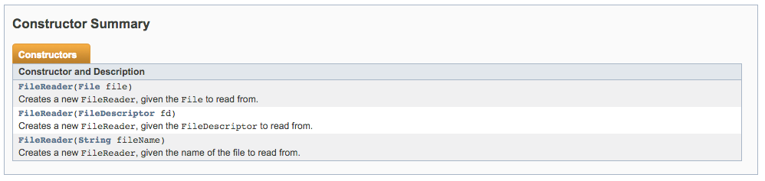
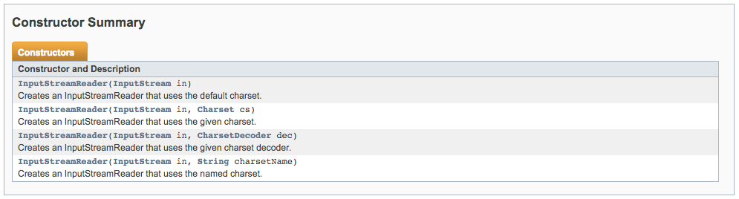
Beware of the FileReader and FileWriter!
no way to specify an encoding!!!
InputStreamReader to the rescue
Reader reader = new InputStreamReader(new FileInputStream(file), “UTF-8”);
is safer than
Reader reader = new FileReader(file); // what is the “default” encoding???

Slide 74
Shit Happens...
Dealing with IO Exceptions

Slide 75
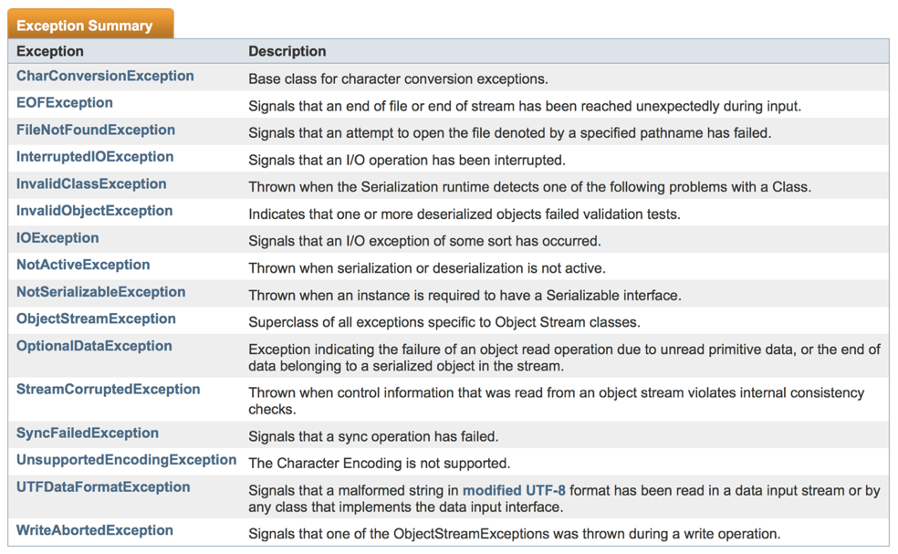

Slide 76
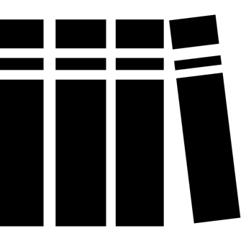
References

Slide 77
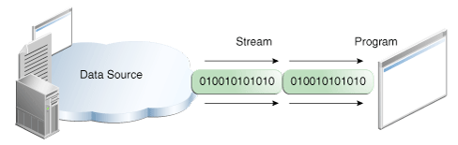
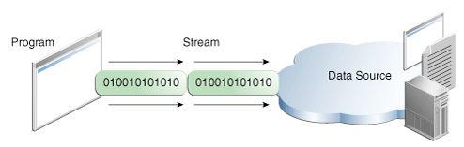
The IO Trail in the Java Tutorial
http://docs.oracle.com/javase/tutorial/essential/io/index.html

Slide 78
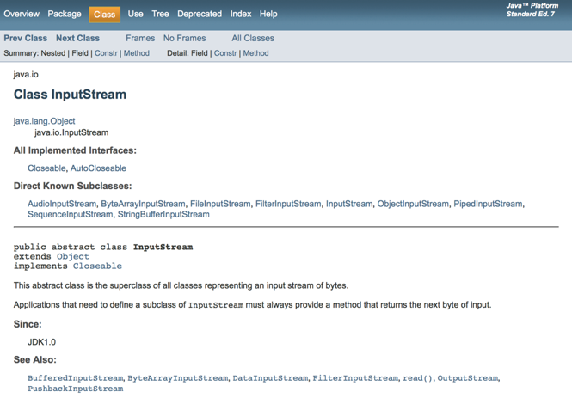
The java.io API documentation
http://docs.oracle.com/javase/7/docs/api/java/io/package-summary.html

Slide 79
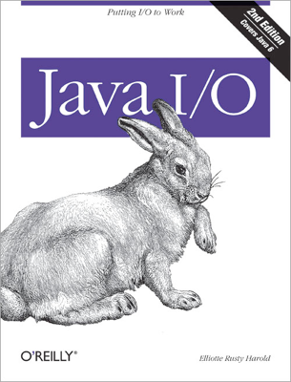
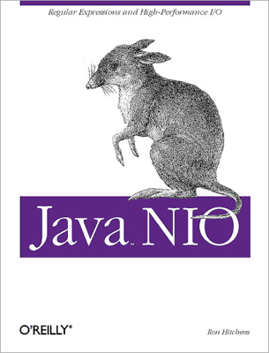
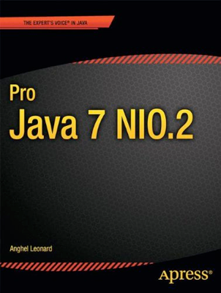
Books

